Slide 1
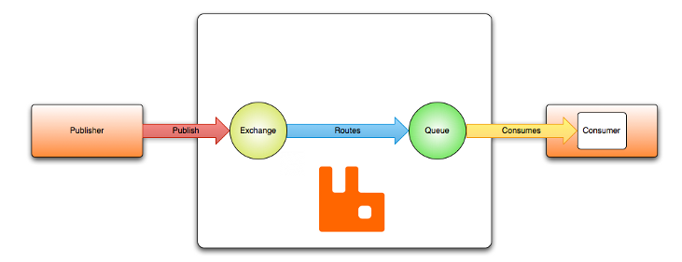
AMQP 0-9-1 Model - Default Exchange
The default exchange is a direct exchange with no name (empty string) pre-declared by the broker. It has one special property that makes it very useful for simple applications: every queue that is created is automatically bound to it with a routing key which is the same as the queue name.
For example, when you declare a queue with the name of “product-queue", the AMQP 0-9-1 broker will bind it to the default exchange using " product-queue " as the routing key. Therefore, a message published to the default exchange with the routing key " product-queue" will be routed to the queue " product-queue ". In other words, the default exchange makes it seem like it is possible to deliver messages directly to queues, even though that is not technically what is happening.
Routing key
=product-queue
product-queue

